Slide 1
AWS Native Basics

Slide 2
Cloud Native Services
Our Cloud-Native services provide the right experts to design, build and manage workloads by taking advantage of AWS cloud computing services.
Our engineers help organizations to build and run scalable application the cloud, and are experienced in containers, Kubernetes, service mesh and DevOps.

Slide 3
Microservices
Build scalable, fault-tolerant Microservice architecture using Twelve Factor design pattern
Design and implement Serverless architecture using AWS Lambda
Containers
Manage containers using Amazon ECS
Container Image Repository using Amazon ECR
Container orchestration using Amazon EKS

Slide 4
Storage and Database
Build object store data lake using Amazon S3
Caching using Amazon ElasticCache
Databases like DynamoDB, RDS and Aurora
Networking
Service Mesh using AWS App Mesh
Load balancing using Amazon Elastic LoadBalancers
API management using Amazon Gateway
DNS route management using Amazon Route53

Slide 5
Messaging/Event Driven Architecture
Event based trigger using Amazon EventBridge
Pub Sub model using Amazon SNS
Message queue with Amazon SQS
Logging and Monitoring
API usage and user activity logging using AWS CloudTrail
Monitor resource and applications using Amazon CloudWatch
Automation
Infrastructure Automation using AWS CloudFormation
Build DevOps pipeline using AWS Code Pipeline and AWS Developer tools

Slide 6
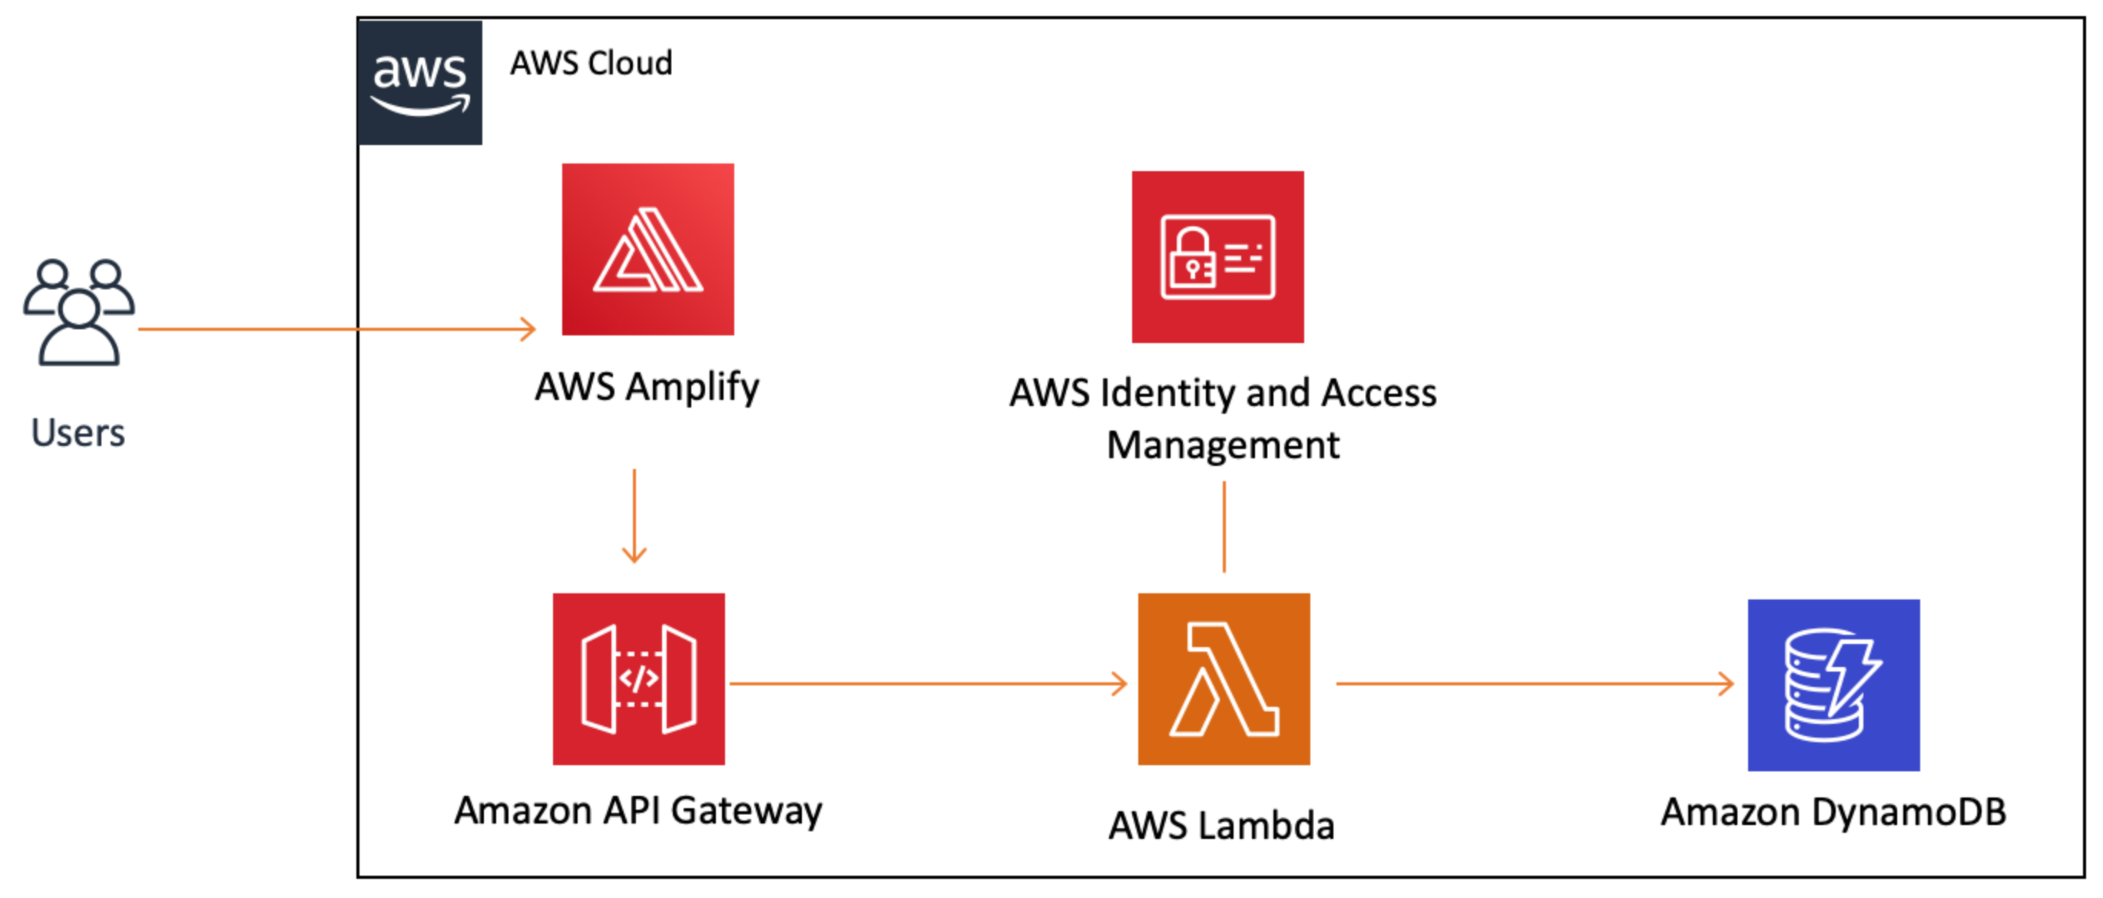

Slide 7
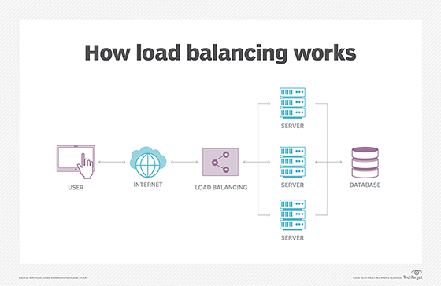

Slide 8
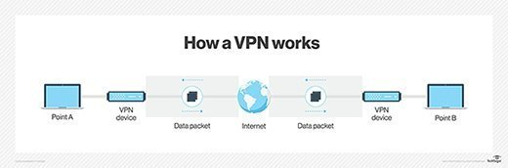

Slide 9
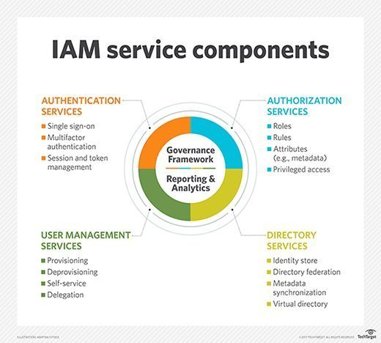

Slide 10
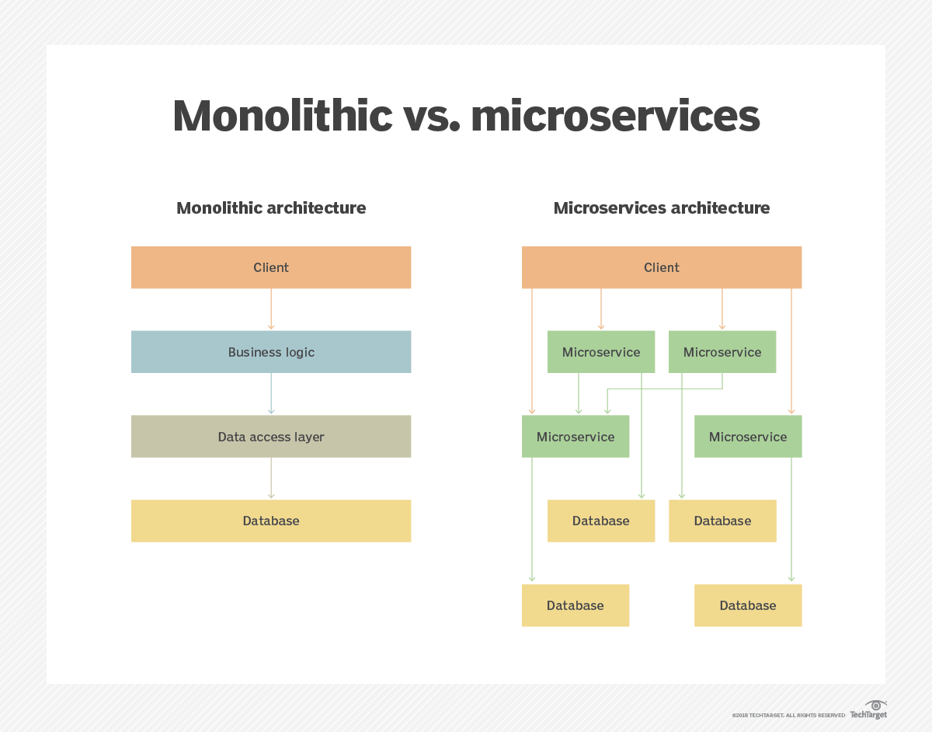

Slide 11
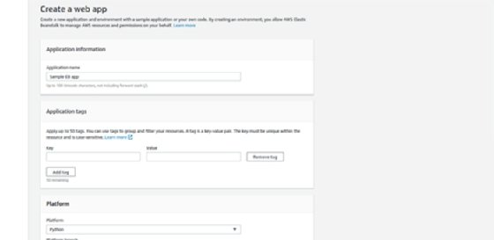

Slide 12
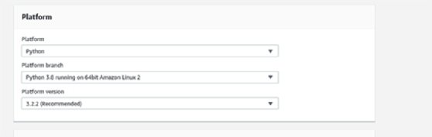

Slide 13
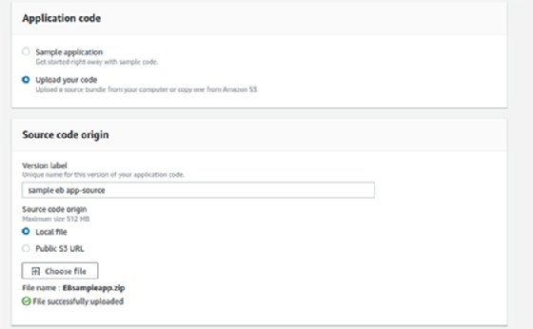

Slide 14
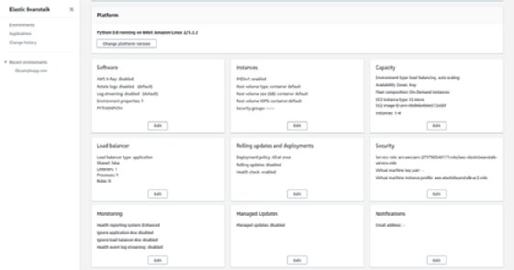

Slide 15
